Slide 1


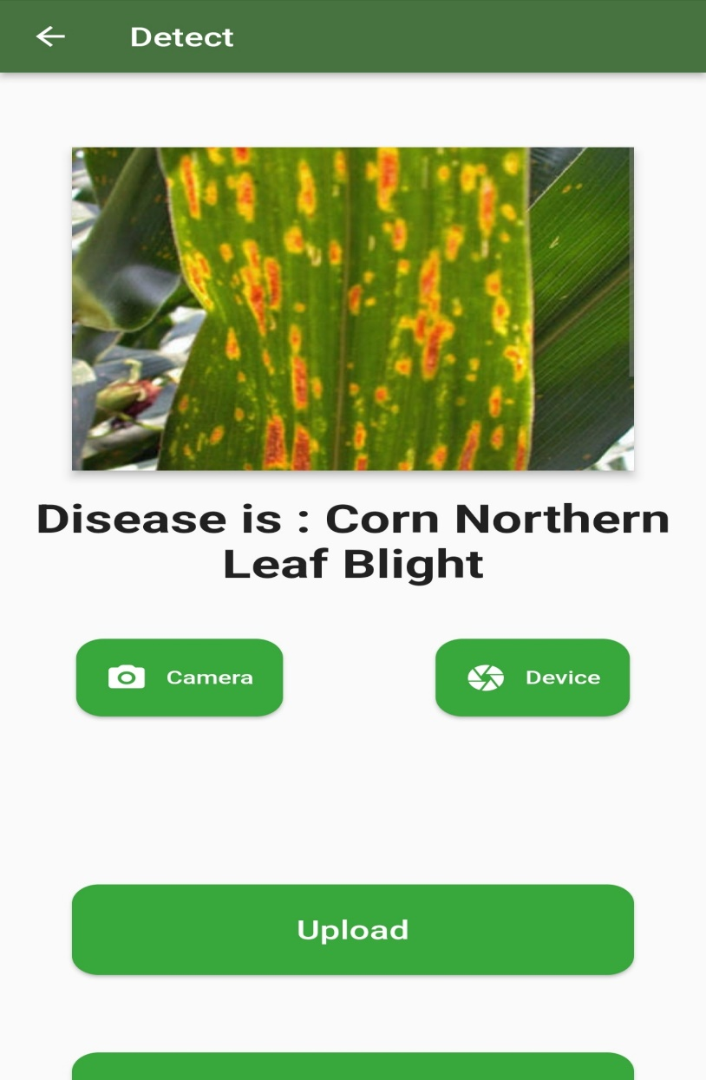
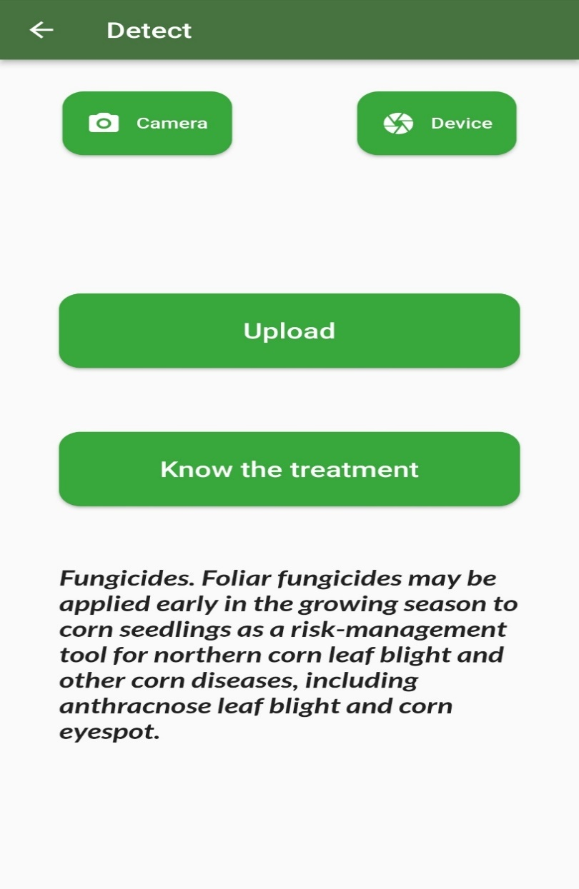
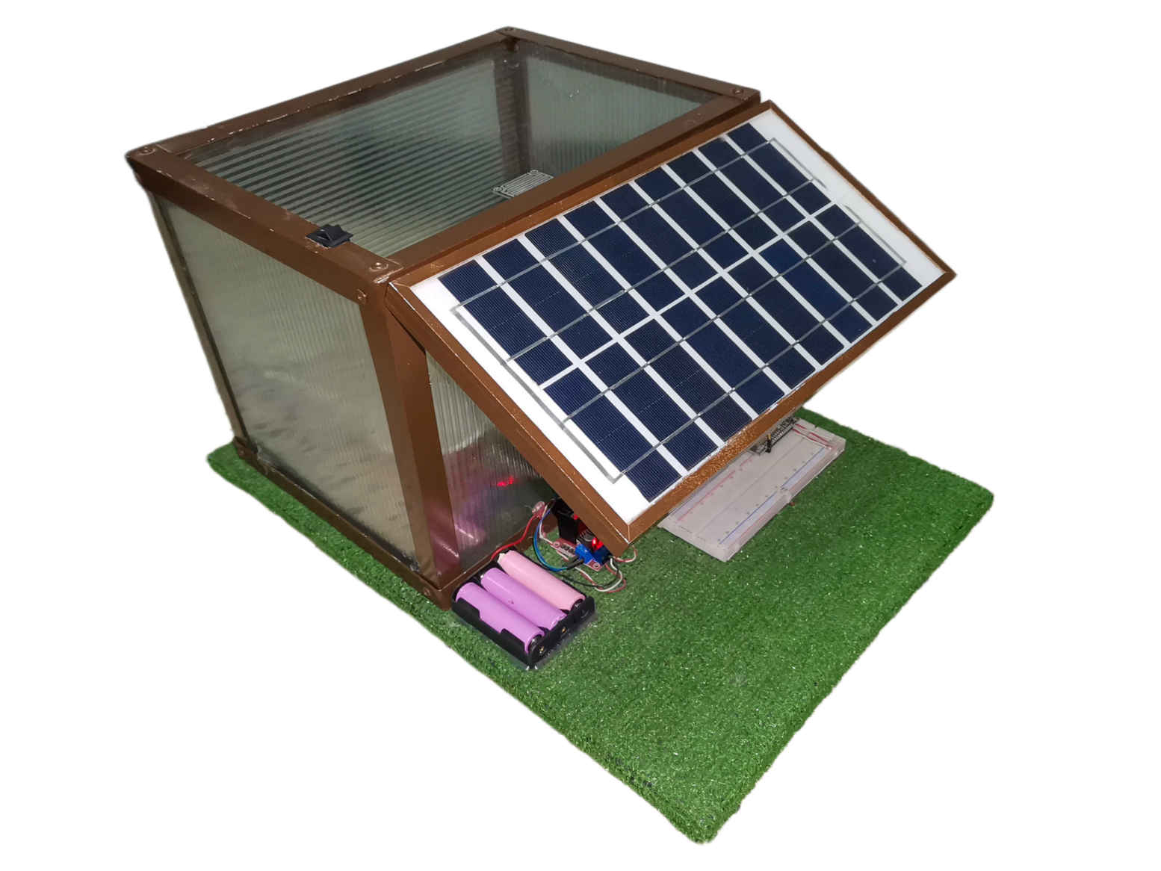
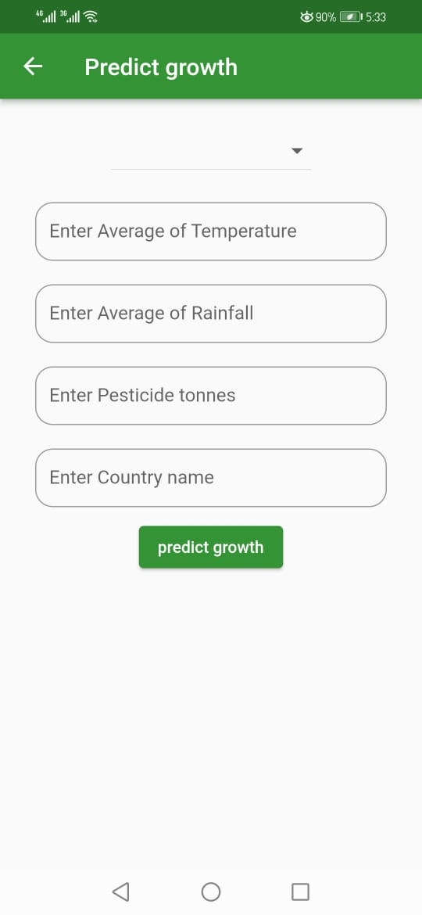
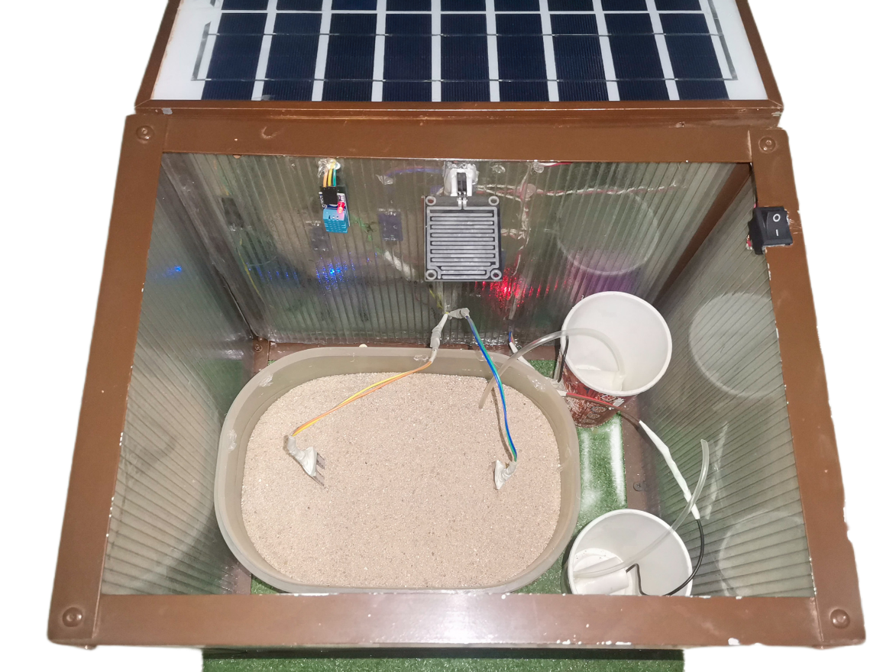
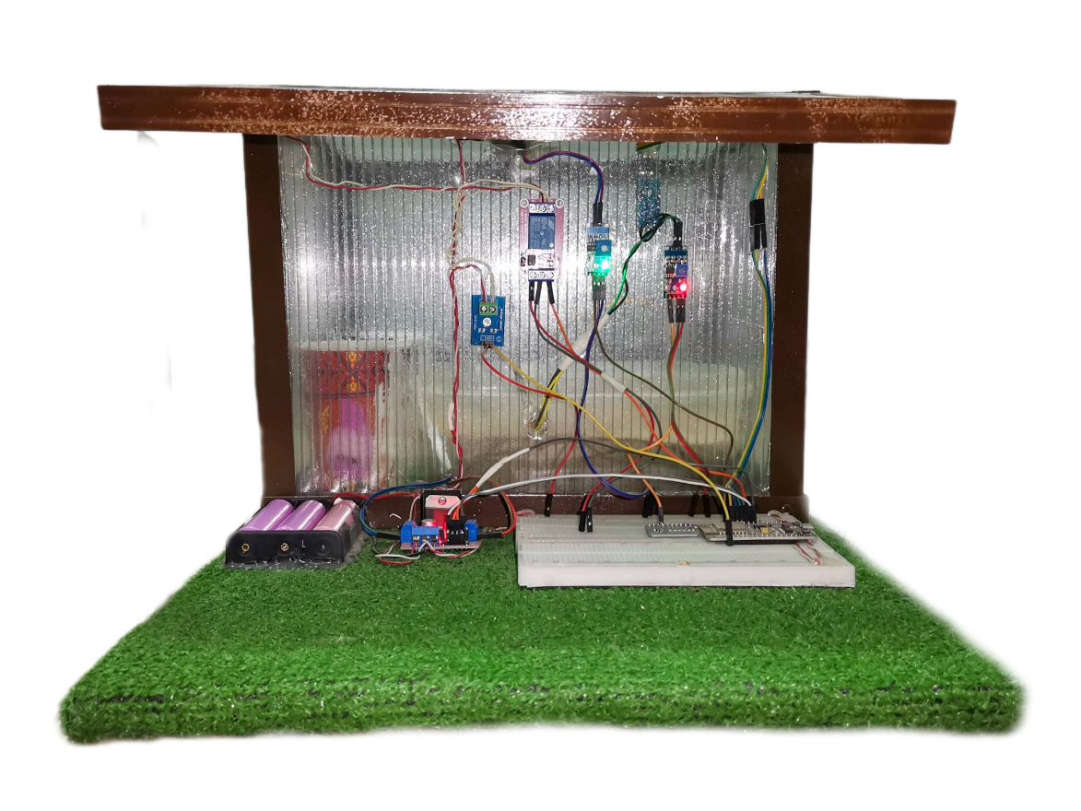
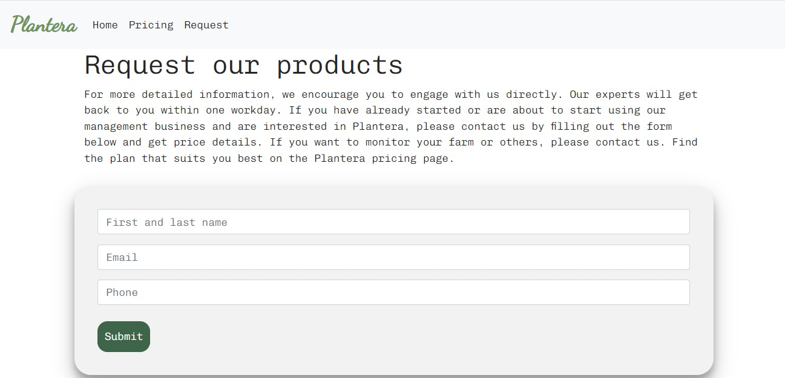
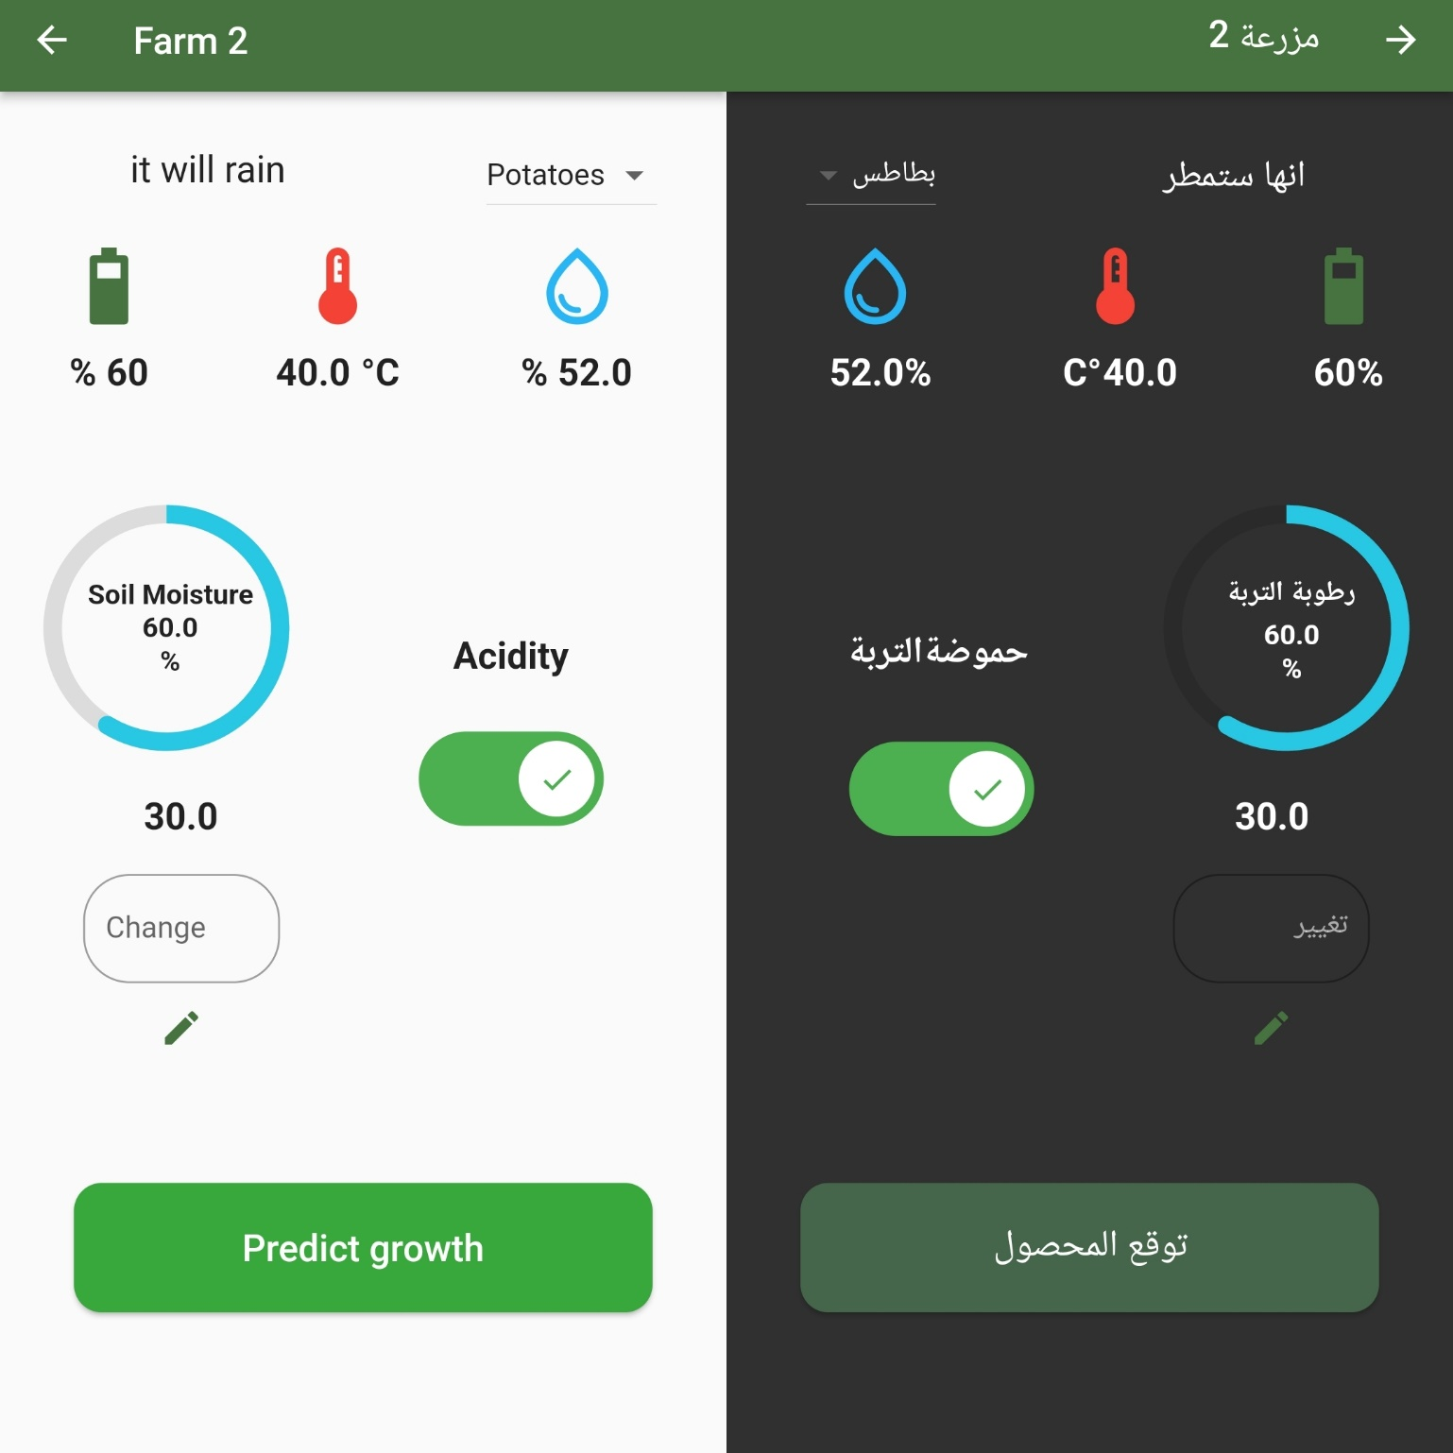
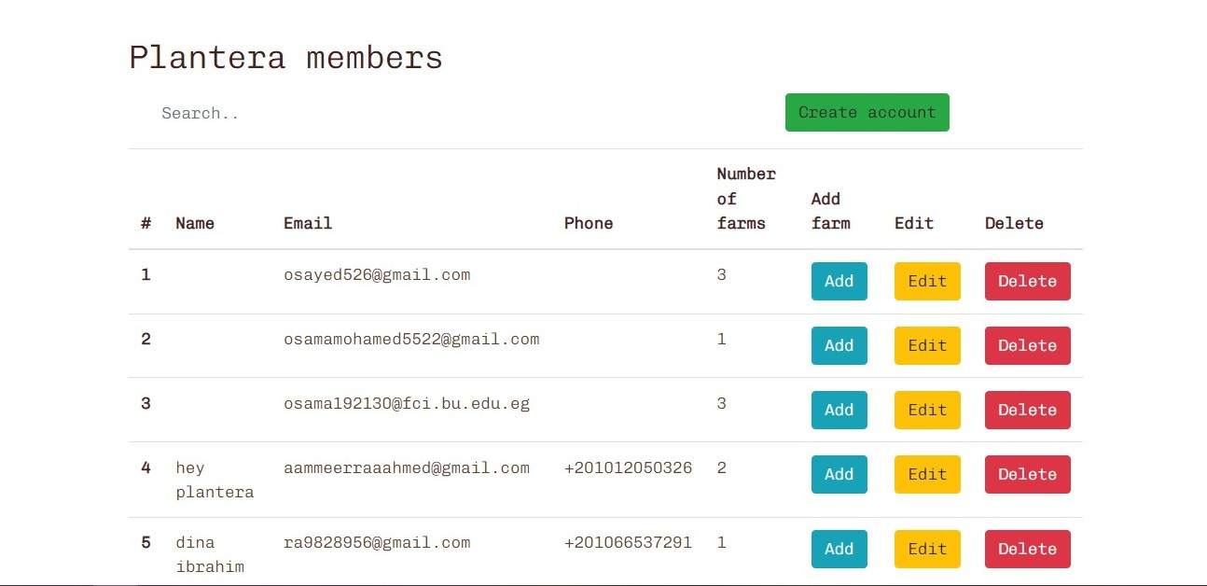
Plantera (Farm automation system)
Ahmed Muhammad, Amira Ahmed, Dina Abdallah, Mariam Hossam,
Osama Mohamed, Osama Sayed
Faculty of Computers & Artificial Intelligence
Supervised by/Dr/ Mahmoud Abdelaal
Benha University
ABSTRACT
METHODS
The world population is increasing rapidly and with the increase in population, our need for food is increasing. Traditional methods that farmers use are not sufficient to serve the increasing demand for food which lead them to use wrong and unethical ways to produce more food which end up destroying the soil, producing low quality food, and resulting in crop diseases.
Some other problems that are facing agriculture field are lack of irrigation and water management.
That’s why our project is using different automation practices using IOT system to control water and other minerals entering the soil, that would give the plants its needs in a responsible and efficient way.
Also, we use Artificial Intelligence and Deep Learning and Computer Vision algorithms to help detecting plant disease and giving recommendation to the user on how to help the plants.
And that’s done through using an integrated system, using AI, hardware and software focusing on some of the pillars of farm automation, that can take care of plants with minimal need for farmers as it includes a smart irrigation system that works based on soil moisture, the actual and expected climate of the farm, and detects common diseases of plants using various techniques of AI and IoT for irrigation
Flutter
Dart
PHP
Firebase
Html
JS
Bootstrap
Python (Flask)
Decision tree regressor
MobileNet v2
The water irrigation system depends on many factors:
Soil moisture that is suitable for the plant.
Next day's weather ( if it's expected to rain, water irrigation stops so that soil won't be super saturated) .
If it rained while the system is working, water flow would stop automatically.
Soil properties is being collected automatically so it will be used in crop yield detection.
If the farmer is suspicious about plant disease, the user can upload a picture of the suspected part of the plant, and using CNN model disease would be detected with a cure for the disease [3].
MATERIALS
To predict crop amount enter avg. temp, avg rainfall, pesticide tones, country name
NodeMCU (ESP8266 Wi-Fi Programming & Development Kit) CP21022.
ADS1115 16-Bit ADC - 4 Channel
Solar Cell Panel (18V – 5Watt) Polycrystalline
Battery Li-ion Battery Cell 3.7v 2400mAh.
DC-DC Step UP Boost Converter Module XL6009 (3A)
Soil Moisture Sensor
DHT11 Temperature & Humidity Sensor8.
Rain sensor
Water Pump – MINI – DC 3-6V 120L/H10.
Motor Driver L298N Module
Relay Module (5V-10A) 2Channel
DC Voltage Sensor Module (0-25V)
BC547 Transistor
INTRODUCTION
CONCLUSIONS
Human society needs to increase food production by an estimated 70% by 2050 to feed an expected population size that is predicted to be over 9 billion people. [1] That is why Agricultural plays important role in the Egyptian economy, as the total domestic production of agriculture, is approximated to 11.4% of the economy, and 23.8% of the total workers in Egypt work in it, but the productivity of agricultural decreased in the period between 1991 and 2019 by 5.8% of the GDP, which led to a decline in the productivity of many strategic crops such as cotton, wheat, maize, beans, and oil crops. Therefore, Egypt suffers from constant challenges and problems regarding the agricultural sector and its negative effects on production. [2]
In conclusion, the use of AI-powered systems in farm automation and plant disease detection has revolutionized the agricultural industry. These systems have the potential to significantly increase crop yields, reduce labor costs, and improve the overall efficiency of farming operations. By leveraging machine learning algorithms and computer vision technology, these systems can accurately detect and diagnose plant diseases, allowing farmers to take timely action to prevent crop losses. Furthermore, these systems can automate various farming tasks such as planting and watering, freeing up farmers' time to focus on other important aspects of their business. Overall, AI-powered systems have the potential to transform the way we approach agriculture, making it more sustainable, efficient, and profitable
RESULTS
To subscribe to our services users, request the system on the website, then a date is set to install the hardware(microcontroller and sensors ).
An email is sent to users with a link to download the app and with their login info.
In the application farm's state is shown (temperature, air humidity, soil moisture, operating system battery percentage).
REFERENCES
OBJECTIVE
[1] "Agricultural Economics Research Institute-Agricultural Research Center," 7 11 2018. [Online]. Available: https://ejar.journals.ekb.eg/article_111119_dbdf9340c176db18d0e102136d29ca30.pdf.
[2] "bnpparibas," 18 4 2019. [Online]. Available: https://economic-research.bnpparibas.com/html/en-US/challenges-agricultural-sector-4/19/2019,32926.
[3] A. a. halidev, "A review on convolutional nueral networ (cnn) applied to plant leaf disease detection".
Our main goal is to build an integrated automated farming system that helps build smart farms and helps farmers provide the best care for plants. By integrating artificial intelligence with the Internet of Things, web technology, flutter application, and AI methods such as deep learning and computer vision that can provide accurate plant care by automatically watering plants at the right time (when they need), with the detection of the climate on the farm (air temperature, the degree of air humidity, the detection of precipitation), with the forecast of the next day's weather through the API to detect if it will rain to stop the irrigation system, and the detection of plant diseases and suggest how to take care of these plants and link these activities in the mobile application for user to monitor farms.
The system works automatically, with an option to manually control it.
Farmers' accounts are being controlled by admin (Deleting farmer's account, deleting farms, editing user's info).
ACKNOWLEDGEMENT
We Would Like To Thank The Dr. Mahmoud Abd-elaal For Continuous Support., and thanks to Eng. Mohamed Mostafa

